Slide 1
Deep Learning using TensorFlow: An Introductory Tutorial
Artificial Intelligence
(AI)
Machine Learning
(ML)
Deep Learning
(DL)
Siby Jose Plathottam
26th October 2017

Slide 2


Deep Learning basics: Writing Machine Learning Programs
Create Model
Training
Inference
“90% probability that this is Homer”
“Homer”
Target Data
Prediction
Input Data
Input Data

Slide 3
Deep Learning basics: What is Deep learning?
Simplest answer: Machine learning using an artificial neural network having many layers.
Artificial Neuron

Slide 4
Deep Learning basics: Brief TimeLine
1957:
Perceptron (artificial neuron)
1969:
Multi-layer perceptron's
1986: Backpropagation
1998:
Convolutional Neural Network
First 50 Years
Last 5 years
2012:
AlexNet
2016:
AlphaGo
2017:
AlphaGo Zero
2015:
ResNet
2016: Microsoft Speech recognition

Slide 5
Deep Learning basics: Why now?
Large data sets:
Image net, Kaggle
Computing resources:
GPU’s, Cloud computing
Better algorithms/models: Convnets, LSTMS, ReLU
Opensource libraries
Deep Learning Library
Computing
Algorithms
Data

Slide 6







TensorFlow basics: What is a Deep Learning Library?
A software library with modules purpose building, training, and inferencing Deep neural networks
Deep learning library menagerie:
https://developer.nvidia.com/deep-learning-frameworks

Slide 7
TensorFlow basics: Why TensorFlow?
Pros:
Google!
Opensource
A lot of firms (Intel, Airbus, Qualcomm…) and universities (Stanford, MIT,..) are using it.
Cons:
Error messages can be cryptic.
Steep learning curve
TensorFlow development timeline
Windows support
November 8, 2015:
TensorFlow 0.5.0
February 15, 2016:
TensorFlow 1.0
August 16, 2017:
TensorFlow 1.3
November 28, 2016:
TensorFlow 0.12
Python API stability

Slide 8

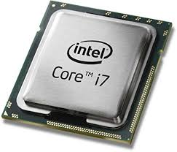

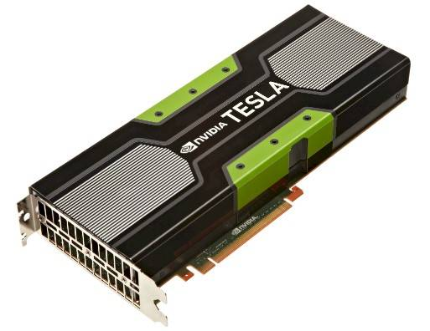

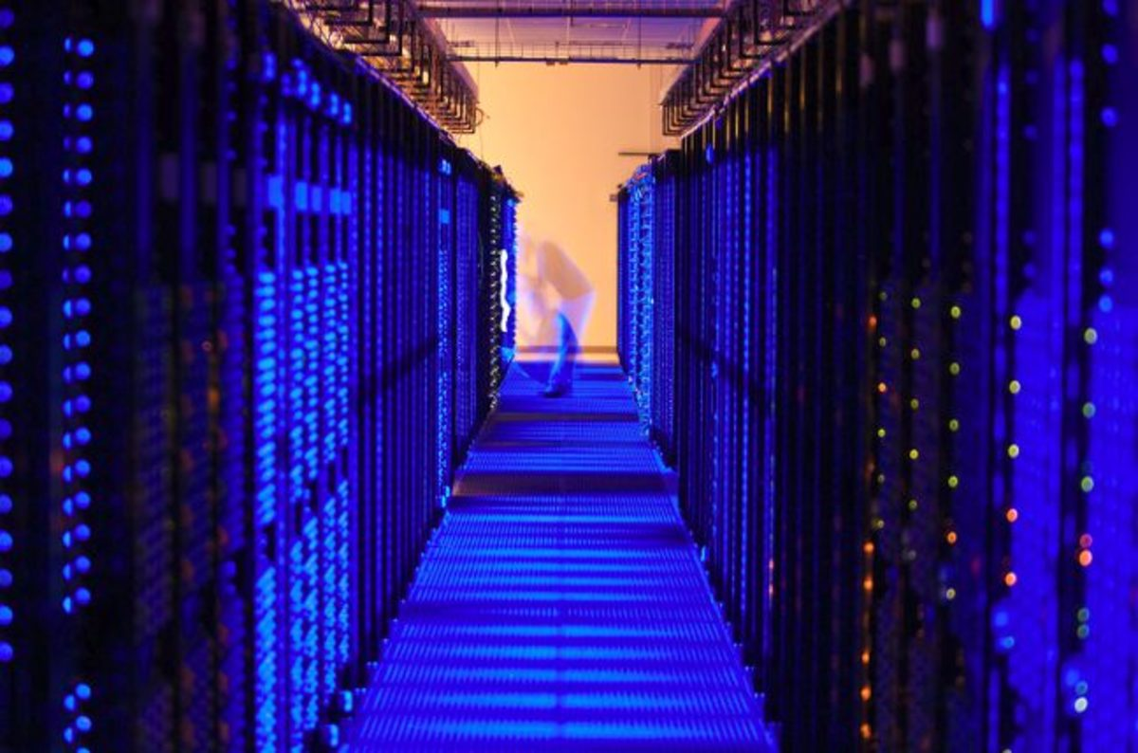

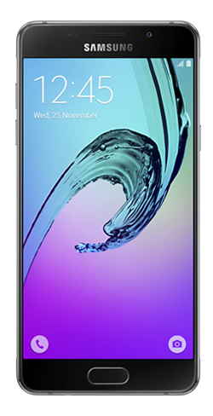
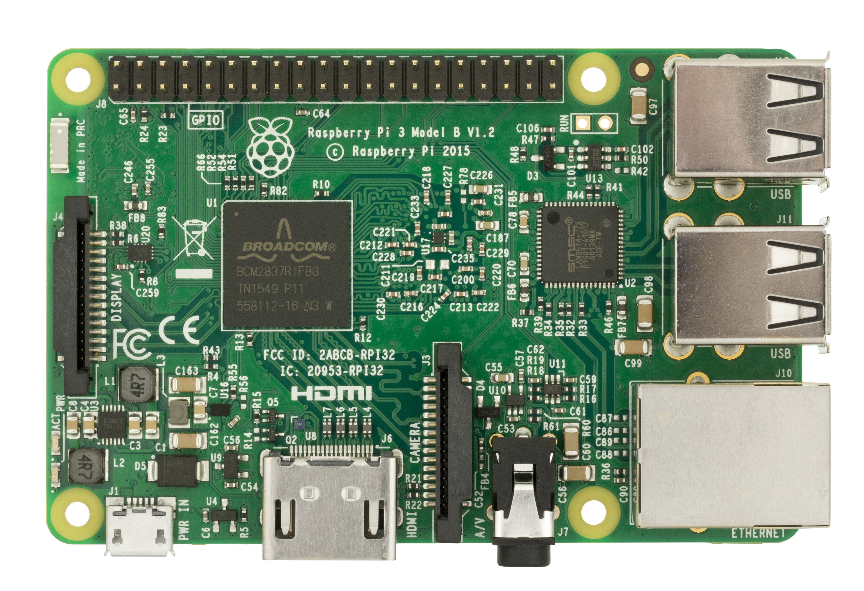
Why TensorFlow?: Same code runs on different platforms

Slide 9
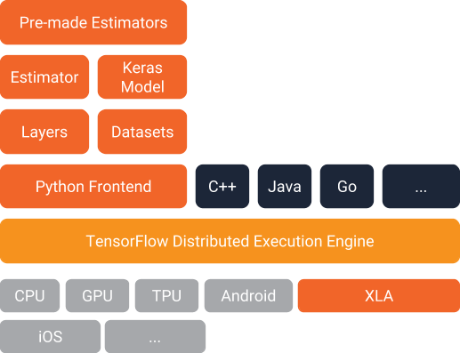
TensorFlow basics: TensorFlow Architecture
We write applications code using these.
Under the hood operations we don’t need to worry about.
Reference: https://developers.googleblog.com/2017/09/introducing-tensorflow-datasets.html

Slide 10

TensorFlow basics: Graph and Session
Example graph
Build Model here!
Define Computational Graph
Create a Session and Execute Graph
Data
Training and inference here!
Reference: https://www.tensorflow.org/programmers_guide/graphs

Slide 11
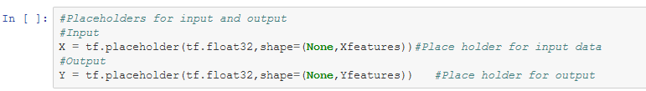
TensorFlow basics: What is a Computational graph?
Data input and output:
Array format
Placeholders: Used to feed data into and out of the model.
Variables: store weights and biases.
Operations: Mathematical operations to build model.
Reference: https://www.tensorflow.org/programmers_guide/graphs

Slide 12
TensorFlow basics: How to build a Computational graph?
Use core operations
Customize model
Useful for learning and simple models
Uses tf.layers abstraction
An abstraction over the core operations
Use Keras API
Easiest method if you want to get something done quickly

Slide 13
TensorFlow basics: Core operations
Basic operations:
Arithmetic & Logical
Matrix manipulation
tf.matmul
Activation functions
Advanced operations:
Generating values following a statistical distribution.
Eg. tf.truncated_normal
Loss functions
Eg. tf.losses.mean_square_error
Optimizers
Eg. tf.train.GradientDescentOptimizer

Slide 14
TensorFlow basics: Feeding Data
Feeding
Simplest method
Needs data to be loaded into Python environment
Queues
Used in production code but not straight forward
Data may be stored on disk and only loaded during runtime
Dataset API
Introduced in 1.3
Alternative to Queues and Feeding

Slide 15
TensorFlow coding demo: predict earthquake magnitude
Goal: predict earthquake magnitude given latitude, longitude, and depth
Source: Kaggle
https://www.kaggle.com/usgs/earthquake-database/data

Slide 16


Keras Coding Demo: Dataset
Goal: Identify members of the Simpson’s family
Data set: The Simpsons Characters Data
Source: Kaggle
Link: https://www.kaggle.com/alexattia/the-simpsons-characters-dataset
Training data tuple
Image as an array of pixel values
Actual
Image
Actual
Label
One hot
Label
A batch of image arrays and one hot labels
Homer
Marge
Lisa

Slide 17
TensorFlow Coding Demo: Code
GitHub repository for code:
https://github.com/sibyjackgrove/simpsons_classifier_with_CNN
Import data from folders containing image files
Build and train a CNN using Keras
Visualization using Tensorboard

Slide 18
Keras Coding Demo: Convolutional Neural Network

